Slide 1


Dynamic Hotel Analytics & Operations Dashboard
Multi-Year Booking Insights
Made By: Dinesh Timande
Guided By: Abhishek Wavhal

Slide 2
Contents
Project Overview
Problem Statement
Conclusion
Excepted Outcomes
Data Visualization and Analysis
Data Cleaning and Transformation

Slide 3
Project Overview
Purpose
Uncover Key Trends In Hotel Booking, Guest Profiles, Cancellations, And Market Channels For City And Resort Hotels.
01
Scope
87,392 Bookings | 177,000 Guests | 178 Countries | Data Covers 2015-2017.
02
Tools
Power BI.
03

Slide 4
Problem Statements
1
2
3
4
Challenges in maximizing revenue
Optimizing occupancy rates
Minimizing booking cancellations
Understanding guest preferences
5
Deciding Price

Slide 5
Excepted Outcomes
1
2
3
4
Improved Revenue Management
Enhanced Guest Experience
Reduced Cancellations Rate
Smarter Inventory Allocation
5
Targeted Marketing and Segmentation

Slide 6
Data Cleaning
1. Extracted data from csv file for analysis.
2. Removed errors, blank records, and duplicate entries to ensure data quality.​
3. Identified primary key for unique record tracking.
4. Checked for null values in each data column.​
5. Checked for desired datatype for each column.
6. Combined separated columns into meaningful columns.

Slide 7
Data Transformation
Added primary key (Booking ID).​
Merged and converted date columns into a unified date column.​
Calculated total number of days from stay columns.​
Combined adults, children, and babies' columns for total guests.​
Replaced null Country values with "Self country".​

Slide 8
Data Transformation
Removed company column with excessive nulls.​
Dropped days_in_waiting_list due to 99% zero values.​
Replaced ADR zeros with its average (133.48).
Filled agent nulls with "walking guest" (direct booking).​

Slide 9
Core KPIs & Metrics
Total bookings: 87.39k
Total guests: 177K
Canceled bookings: 24K (27.5% rate)
Check-outs: 63K | No-shows: 1K
Global Reach: 178 countries
Main Channel: Online TA (City Hotels dominant)

Slide 10
Data Visualization

Slide 11
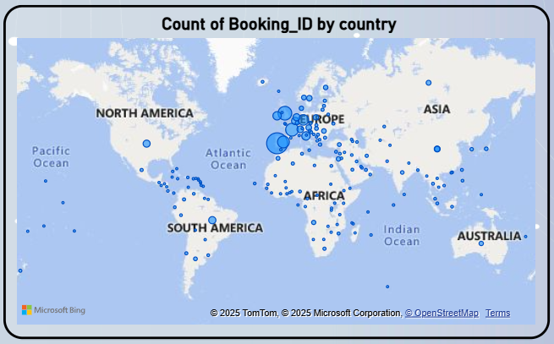
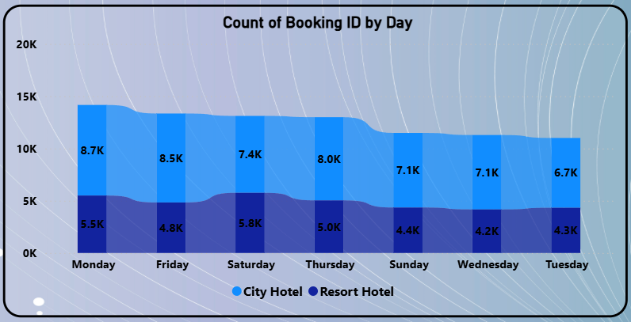
Majority of bookings are concentrated in Europe.
North America, South America, Africa, and Asia display lower booking counts.
City Hotels consistently have higher booking counts than Resort Hotels across all days of the week
Fridays and Saturdays show a slight increase in Resort Hotel bookings compared to surrounding days

Slide 12
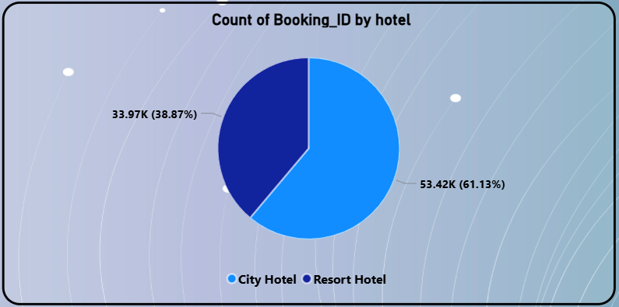
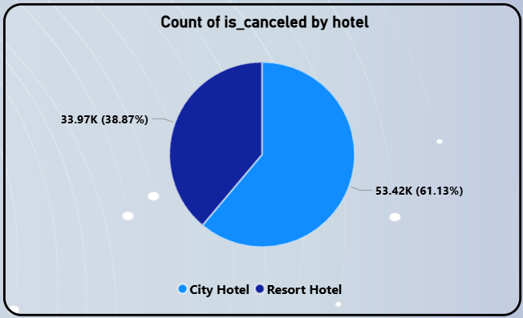
City Hotels account for the majority of bookings with 53.42K, and Resort Hotels have 33.97K bookings.
City Hotels are clearly more popular compared to Resort Hotels.
City Hotels have the highest count of cancellations.
The cancellation rate is significantly higher for City Hotels compared to Resort Hotels.

Slide 13
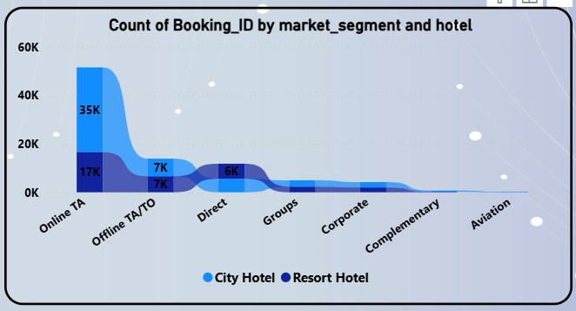
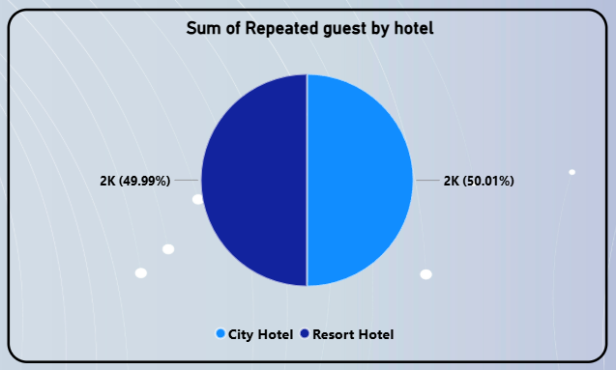
Online TA (Travel Agency) is the dominant market segment.
Offline TA/TO (Tour Operator) and Direct segments are demonstrating similar performance.
The number of bookings from Groups, Corporate, Complementary, and Aviation segments is much lower.
The number of repeated guests is nearly identical for City Hotels and Resort Hotels.
City Hotels have a slightly higher percentage at 50.01%, while Resort Hotels contribute 49.99% of repeated guests

Slide 14
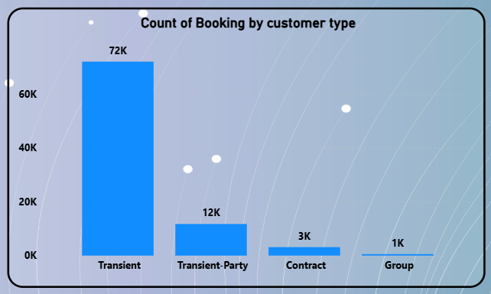
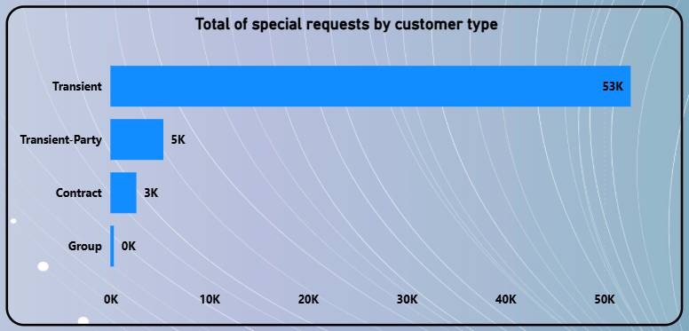
Transient customers account for the majority of bookings.
Group bookings represent the lowest share among all customer types.
Individual travelers (Transient) are much more likely to request special accommodations compared to other customer types.
Contract customers submit 3K special requests, while Group customers make very few or no requests.

Slide 15
Dashboards

Slide 16
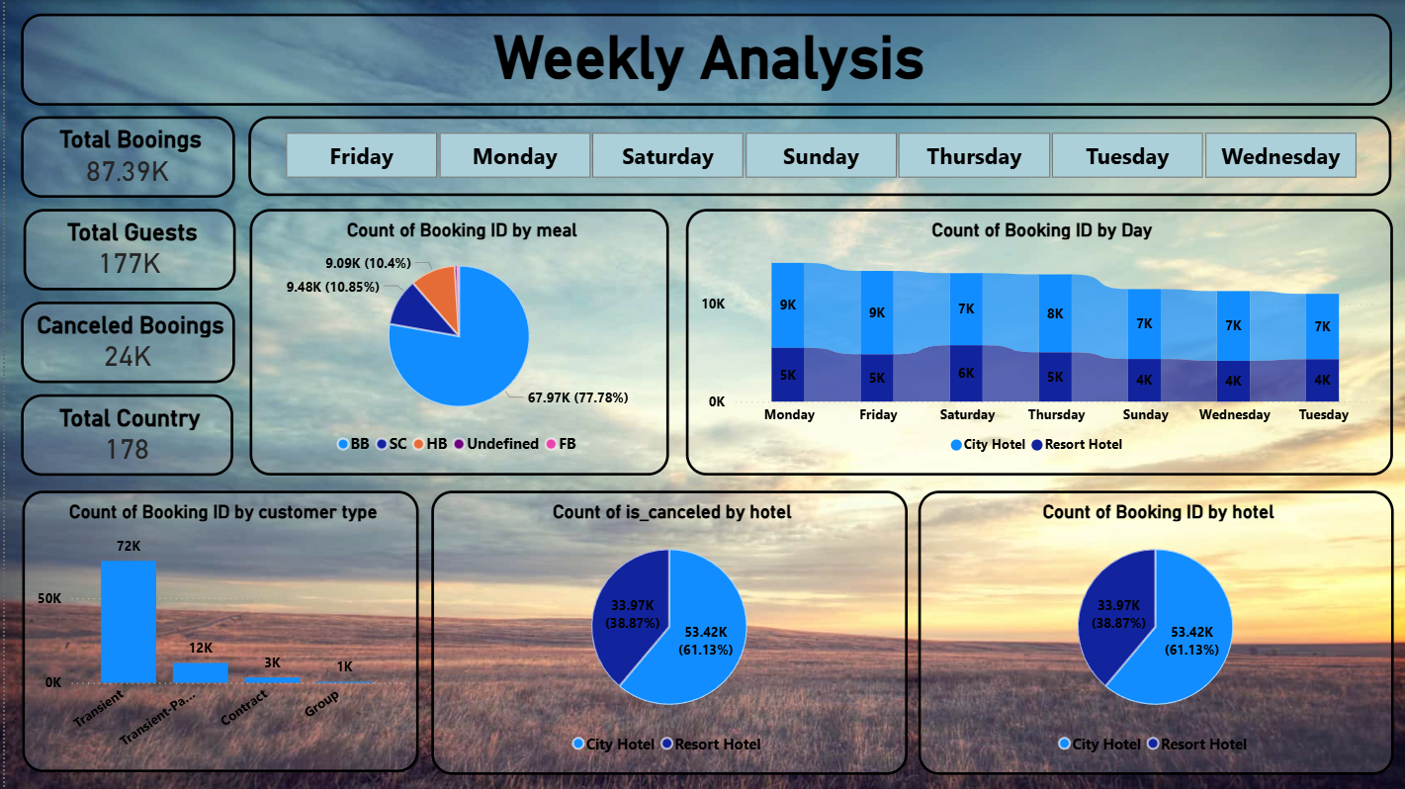

Slide 17
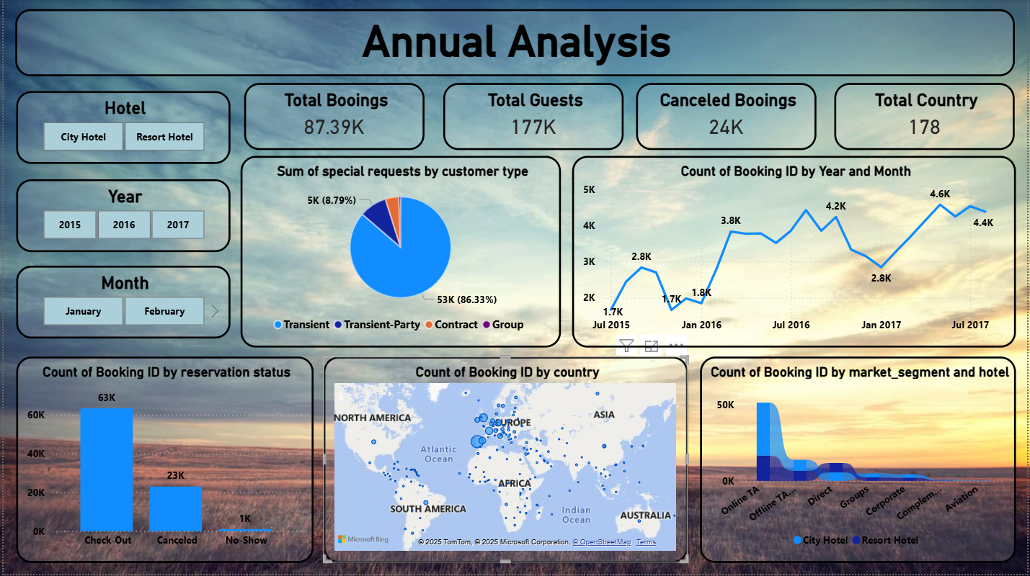

Slide 18
Recommendations
Optimize pricing and promotions
Reduce cancellations and pending bookings
Boost inventory and room mix
Focus on Guest Satisfaction
Retention & Loyalty
Upsell Opportunities
Operational Planning

Slide 19
Conclusion
Data-driven decisions for sales, operations, and marketing.
Actionable insights that boost business performance.
Dashboarding helps hotel managers to gain valuable visibility into daily operations.
The results support smarter pricing.
Improved guest experience.
Proper marketing and inventory management.
Long-term strategic growth within the competitive hospitality market.

Slide 20
Thank You

